Slide 1


Voice Assistant in Healthcare for Elderly People
Group 5
Phurichaya Choksettakit
Navapat Jesadapatrakul
Tanawat Poirojpanya
Nguyen Duc Tho
Reia Tanabe

Slide 2
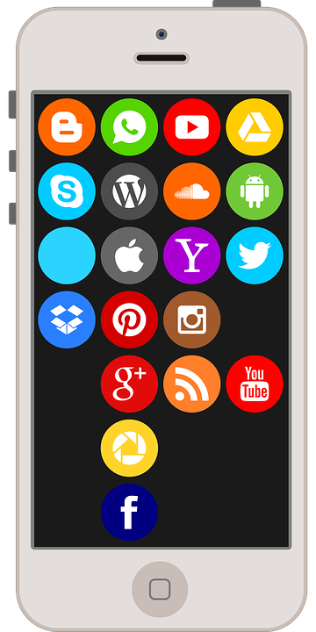

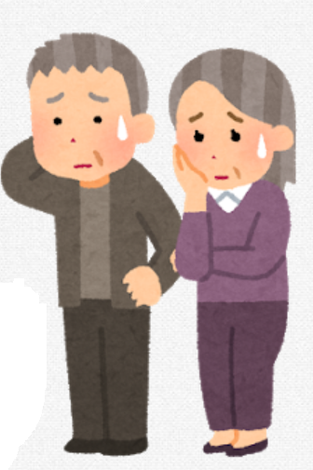


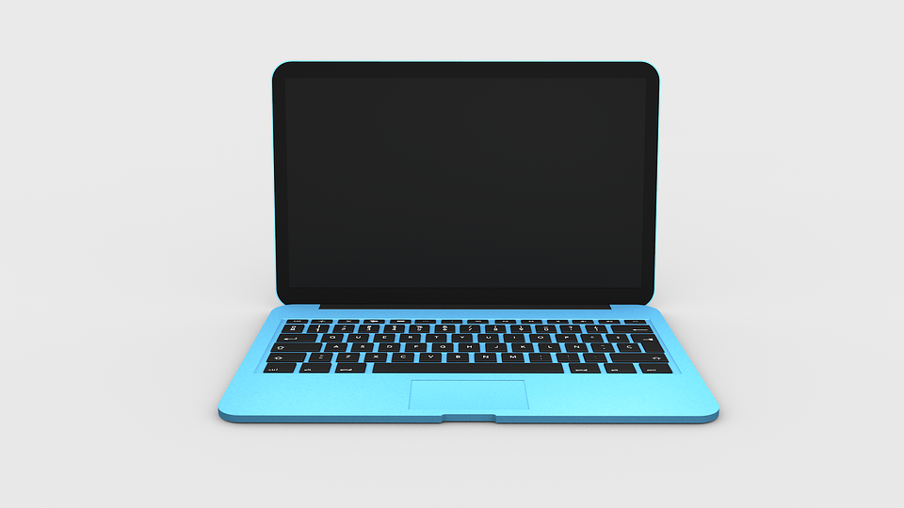
Motivation
Difficult for elderly
Long queue at the hospital
Notes:
Recently, Technology is evolving while the elderly are increasing.
・Using complicated device is difficult for the elderly people
(Especially in Japan, increasing number of elderly live alone)
・Patients are waiting too long on the queue
Because of Doctor and nurse shortage

Slide 3
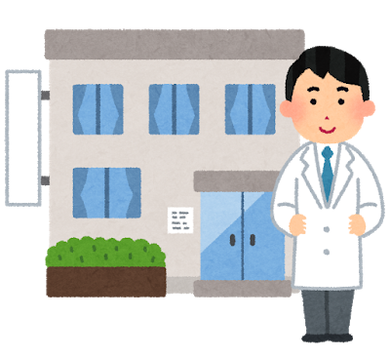
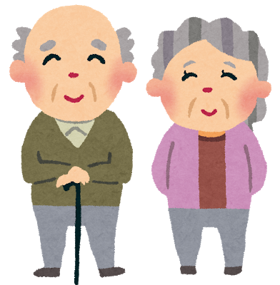
Motivation
・Easy for elderly
・Reduce hospital waiting queue
Notes:
reduce hospital waiting queue , easier for elderly patients to make an appointment or call for an emergency

Slide 4
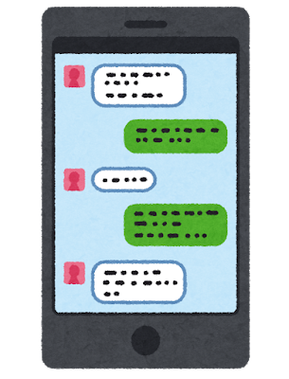

Related works
Chatbot
A Chatbot System for Mental Healthcare
Based on SAT Counseling Method
Online Schedule
The Acceptance of Online Booking System (OBS) Based on the
Theory of Reasoned Action(TRA): A Case of Sana’a University
Notes:
EBSCO → Username : tni
Password : library@2562
Chatbot Paper :
→ This study proposes a new version of the course using smartphones and chatbots to enhance its convenience for use and to maintain user motivation for daily and repeated use.
Link : http://web.b.ebscohost.com/ehost/pdfviewer/pdfviewer?vid=1&sid=5907fc7f-19d1-4b55-901b-a98df5ee088a%40pdc-v-sessmgr02
SAT → The SAT method is an interview-style counseling and therapy techniques
Online schedule Paper :
→ This paper mainly was conducted to measure the user acceptance towards the new online booking system (OBS) for the meeting and seminar halls in the Graduate Studies of Sana’a University.
Link : https://pdfs.semanticscholar.org/c2bd/464eb3b3971049fc126d4ad748e50a6f4ed2.pdf

Slide 5

Proposal
“Voice assistant”
Electric screen
Microphone
SOS
Emergency Button
Notes:
This is the simple illustration.
The device we propose has only a button, screen and microphone.
Usually talk to device, and press the red button in case of emergency.
Device answer is displayed on the electric screen and guided by voice.

Slide 6


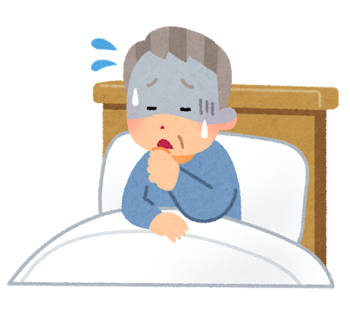
Proposal - Workflow
Voice
Internet
SOS
Voice
Internet
Patient
(especially elderly)
Device
Hospital
Notes:
Between Patient and Device are interact by voice and Device and Hospital is connected by Internet.
=> Mainly focus on the communication between Patient and Device.

Slide 7
Proposal - Workflow
I have a cold.
BOOKED
Agree
Disagree
Symptoms
RESCHEDULE
Schedule
SOS
Notes:
Two main steps:
First, Patient ----symptoms-----> Device ----symptoms----> Hospital (Staff will diagnose and make the schedule)
Then, Hospital -----schedule------> Device ------schedule-----> Patient
=> Mainly focus on first step.

Slide 8
Proposal - Workflow
Hello
Hi! How are you?
I am sick
Do you have a cough?
Yes
SOS
How about ABC hospital at 3pm today?
That sounds good
OK. Hope you will get better.
Notes:
1. Greetings (When patient greet to the device, it will auto start recognizing the voice, just like Siri on iPhone or Google Assistant on Android)
2. Patient tell their own symptoms
3. Device asks for more information
4. Patient give details
5. Device scheduled hospital
6. If patient accept the device’s offer, hospital booked
If patient don’t accept, device will reschedule

Slide 9
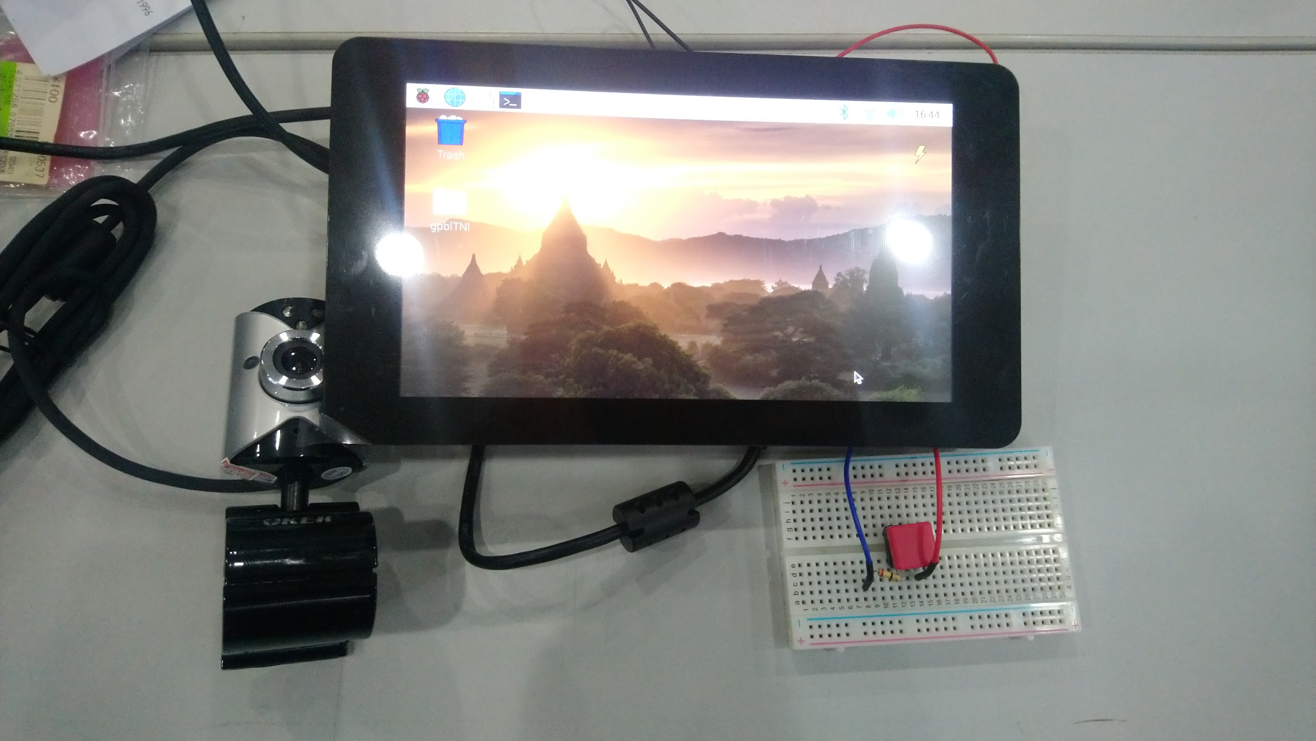
Implementation
Electric screen
Microphone
Emergency Button

Slide 10
Implementation
Voice (Symptoms)
Voice
Google Speech-to-Text API
Google Text-to-Speech API
Text
Text (Schedule)
Natural Language Understanding model
Dialogue model
Useful Information
Answer
Notes:
Input: Voice (for example: greeting, patient’s symptoms)
Output: Voice (for example: about schedule)
So how does the device work in the back-end?
1. Voice -> Text using Google Speech-to-Text-API (require Internet)
2. Text -> Voice using Google Text-to-Speech API (require Internet)
3. 2 Deep Learning model:
Natural Language Understanding model: understand user message in natural language and extract useful information (their intent, symptoms, agree/disagree)
Dialogue model: remember the conversation’s context and decide the answer
We prepare the dataset manually to train

Slide 11
Demo
Notes:
Click <Demo> to go to youtube video

Slide 12
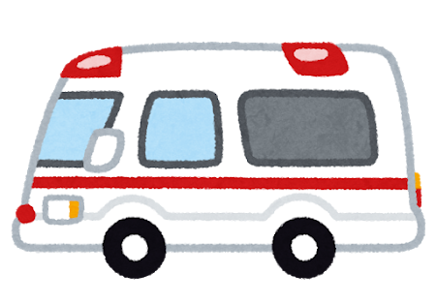

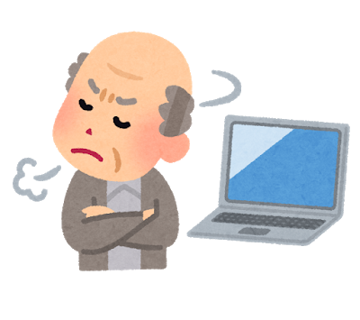
Discussion
Advantages
Convenient for elderly.
In emergency , call ambulance easier.
Disadvantages
The device is slow.
Unreadable by pronunciation
I said the words but...
!@#^*#%(*^#%#*(#&#^^$^
Notes:
Sometimes it knows wrong word because of pronunciation.

Slide 13
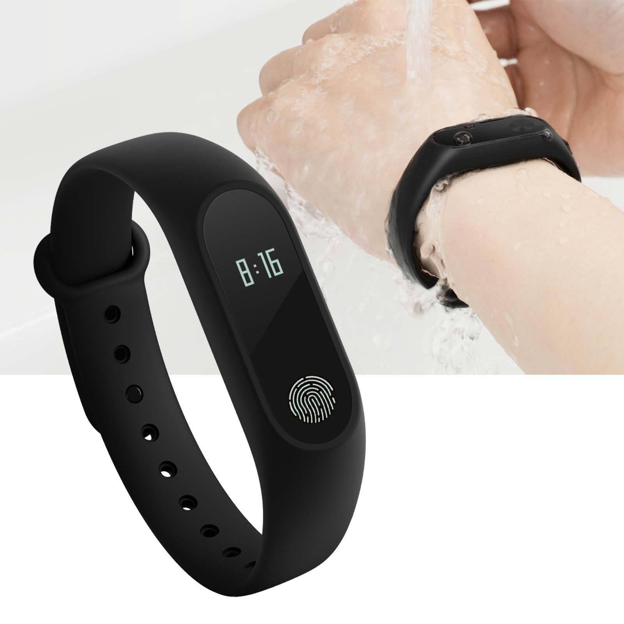
Future works
Make our device
Speedy
Health advice
GPS
Smaller (device miniaturization)
Wearable for the elderly people
Waterproof
Notes:
Make our Device more speedy response
Using GPS and identify nearby hospital
smaller(device miniaturization)
Wearing device alike smartwatch
waterproof

Slide 14
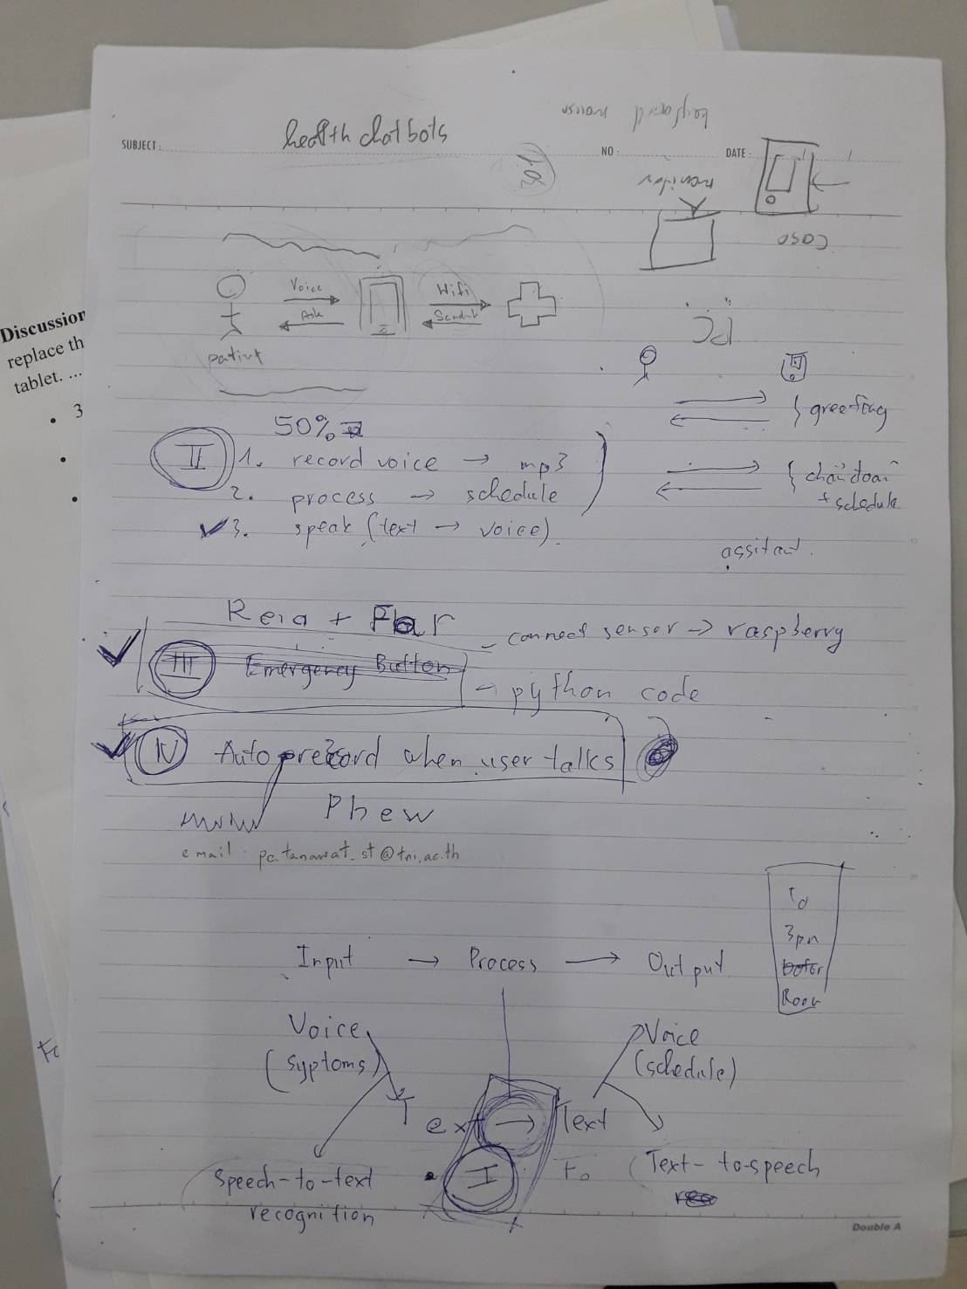
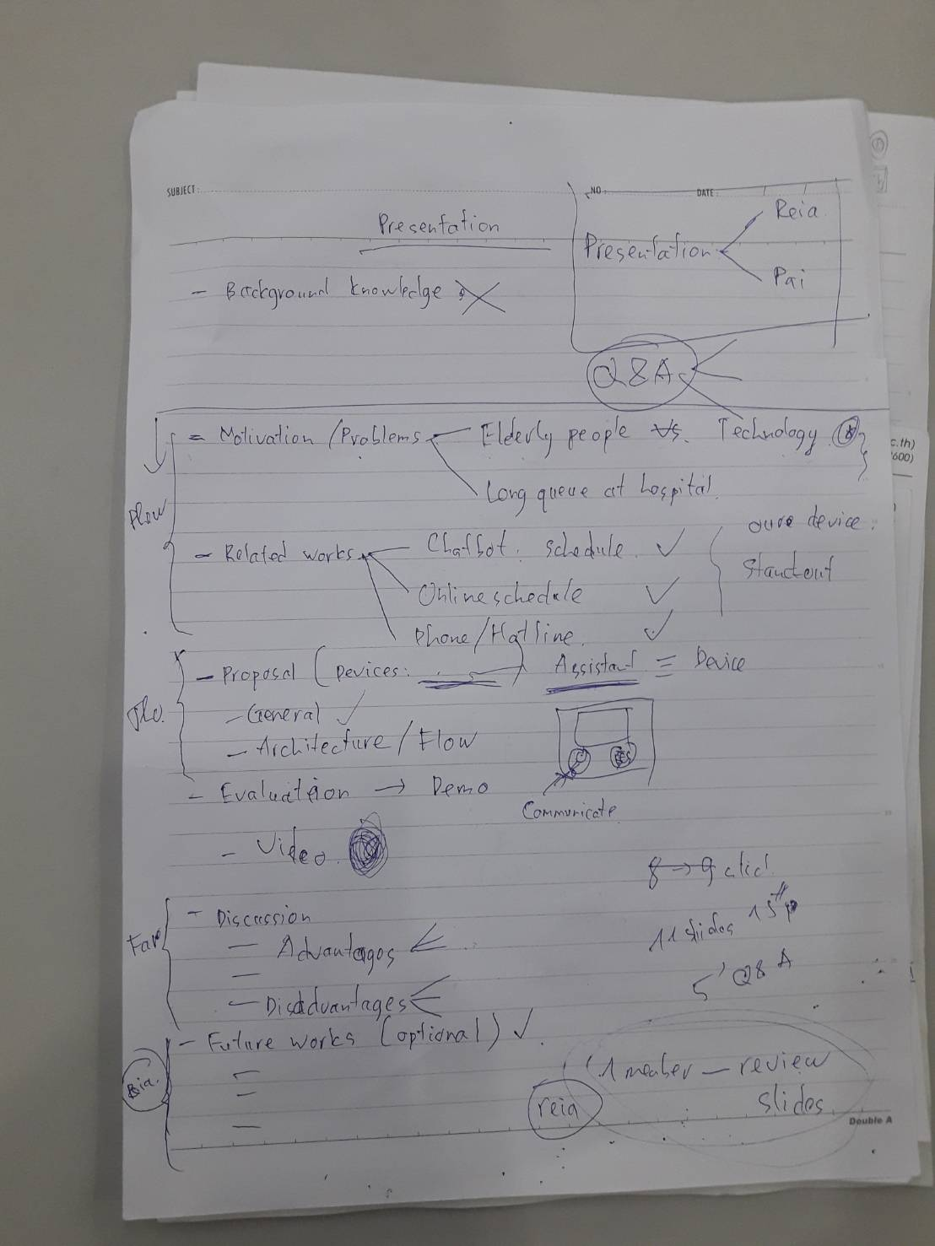
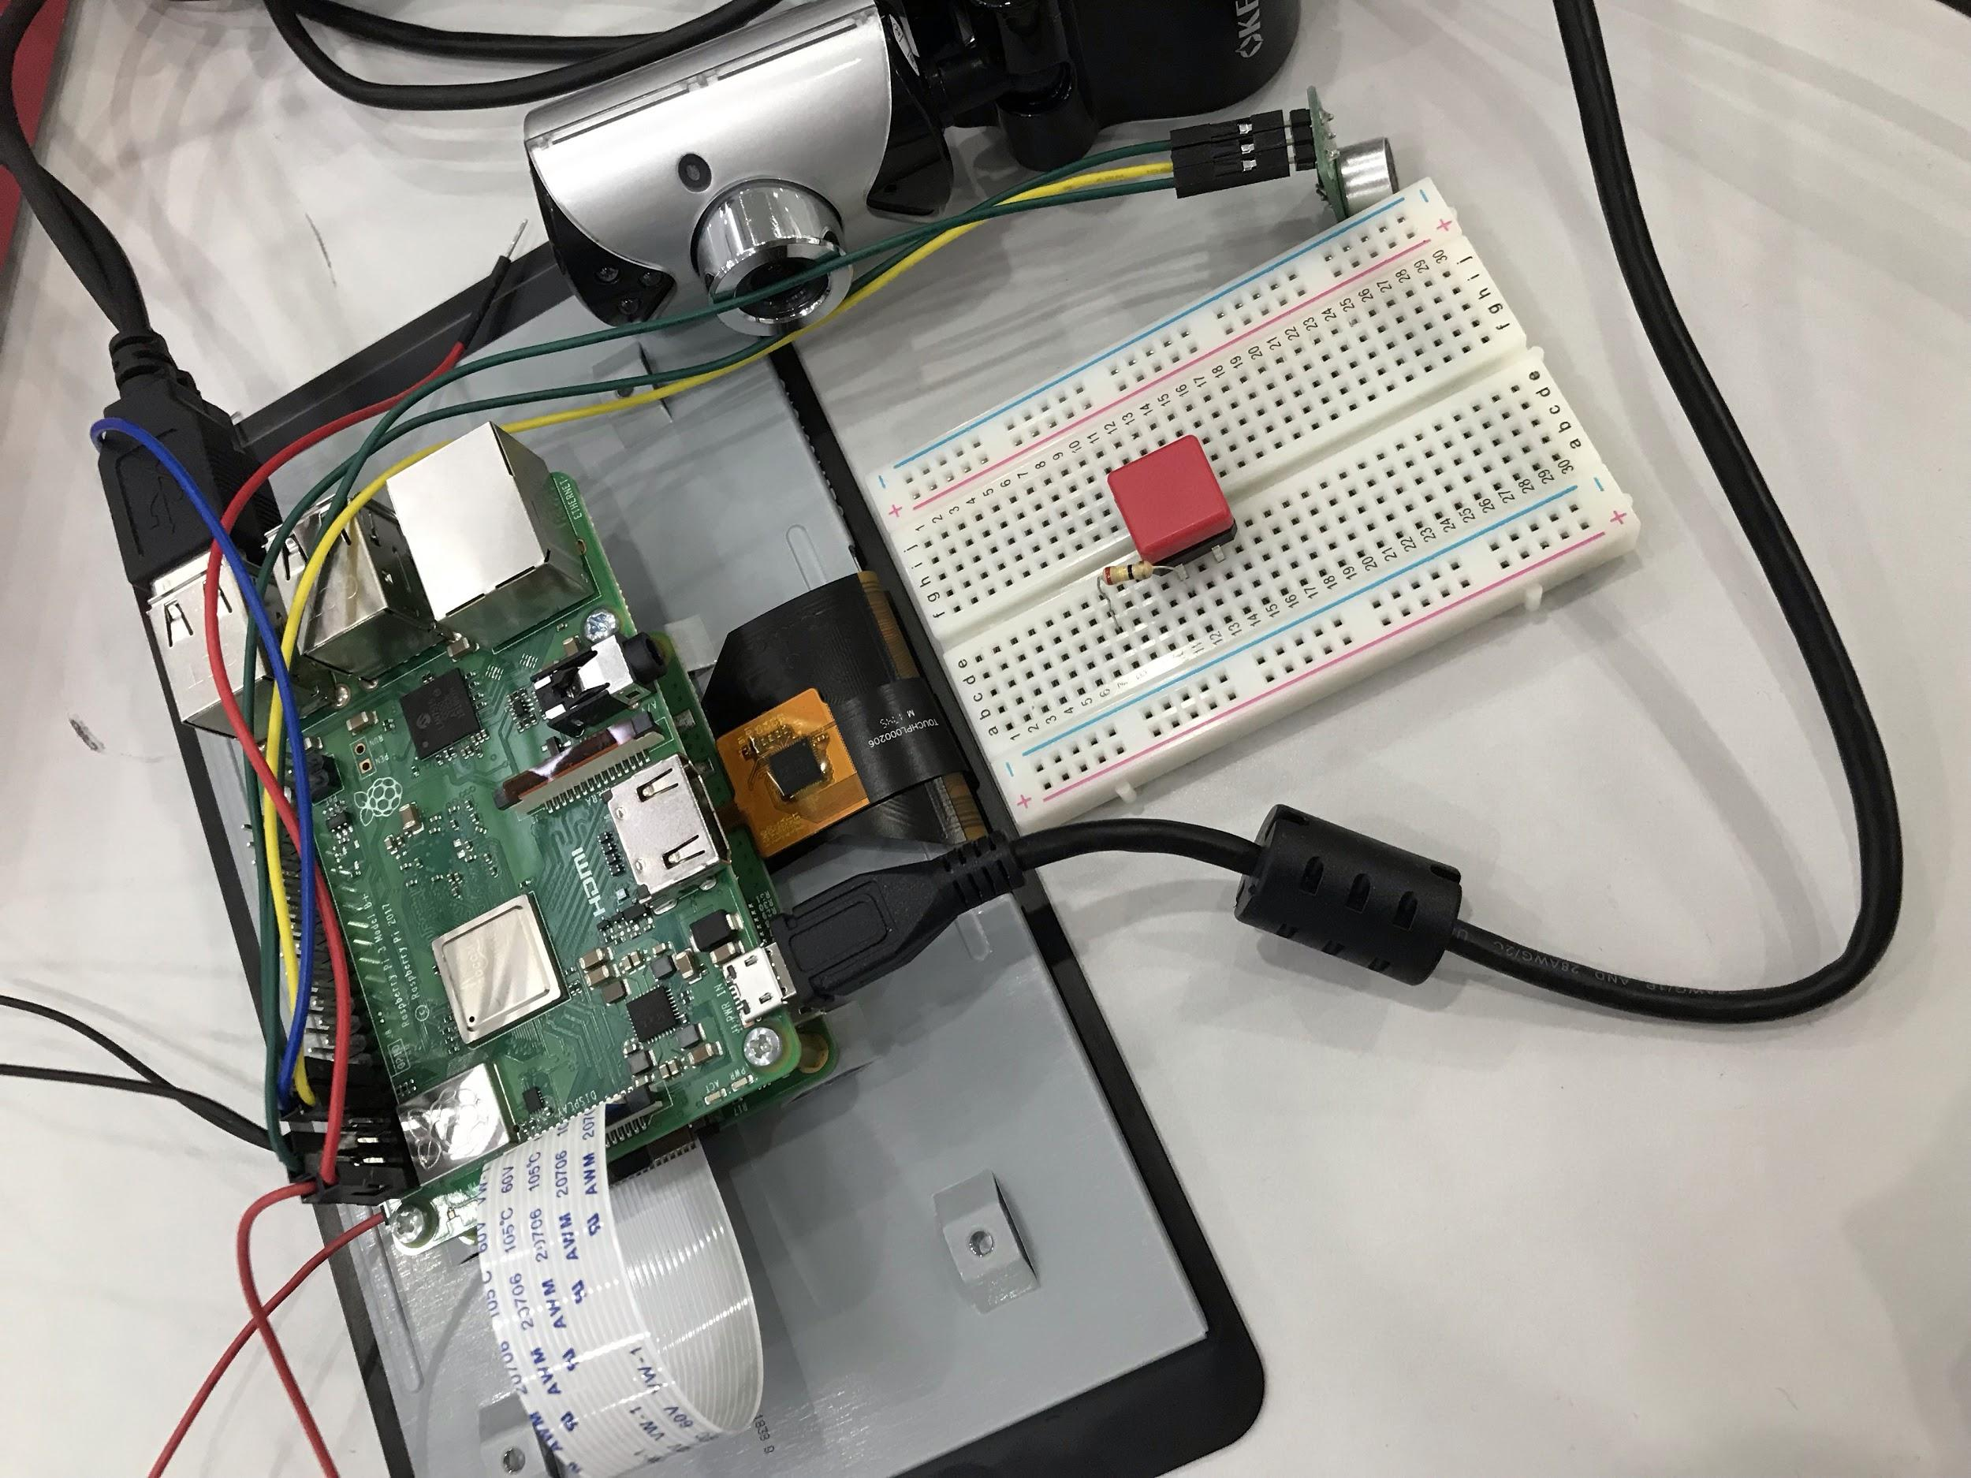
Process of gPBL
Day1(03/09/19) ・Discussion about the topic
・Finding the problems
・Selecting the best solution
Day2(04/09/19) ・Selecting the equipment
・Starting to make a device
・Coding
Day3(05/09/19) ・Continue to make a device
・Coding
・Starting to make a presentation
Day4(06/09/19) ・Coding
・Demonstration
・Make and practice presentation
Notes:
This is our process of this gPBL.

Slide 15

Thank you for listening

